Slide 1

Online Event Planner

Slide 2
Online Event Planner
Presented By
Aparna Singh(2000290140025)
Anshika Sharma(2000290140021)
GROUP NO : G39
Mentor name : Amit Kumar Goyal

Slide 3

Welcome

Slide 4
Objective
This website provides facilities to users to organize the events or parties.
This project will help the users to have a look around the resorts, farmhouses and caterers around their areas.
This project will help the users to participate for any happening events from anywhere.
This project will help any colleges, schools and any companies to contact our company to organize the events.
This is will help the event manager to track the records of events happened in one year.
This is will give the user brief description about the services provided into a particular event.
This project will save the time of clients and will reduce the paper work.

Slide 5
FUNCTIONAL REQUIREMENTS
1. Admin:- In our organization Admin has rights to provide access to the users
request for best event. Admin allots a unique id & password to each user. Admin
can also add, delete and update the details of editor and users.
2. User:- Users can login with unique id & password after registration. They can also
check their status of request and can query about request if any delay. They can
also update their details.
3. Event Manager:- Event Manager is responsible for monitoring of request those
are done by the admin. Event Manager review the events and then collect info about it
and after that send back to admin.

Slide 6

NON FUNCTIONAL REQUIREMENTS
They define the properties or qualities of a
product including usability, efficiency, performance, space, reliability, portability etc.

Slide 7
NonFunctional Requirements
Secure Access of confidential Data(User’s detail)
24X7 Availability
Better Component design to get better Performance at peak time
Flexible service based architecture will give highly desirable for future Extension.c

Slide 8
Software Requirements
Language :Php
Front end :Php
Database: mysql

Slide 9
Hardware Requirements
System Operation : Windows 10 or later
Ram : 4 GB
Hardware Capacity : 3GB or higher
Processor : intel core i5

Slide 10
Modules of the project
1 Admin
2 User
3. Event Manager
4 Report Generation

Slide 11
It will generate the report in yearly basis and will tell about the person attended that event. It will tell about the how many event mangagers were included in that event. It will tell about the expenditures and revenue about the events. It will genrate about the money invested in each props and stuffs which were included in that events.
ABOUT REPORT GENERATION
ABOUT EVENT MANAGERS
There will be one event manager for one event and that manager will assign his team for that events. Event manager is responsible for meeting the clients and discuss their demand and ensure that their team is working properly or not.

Slide 12
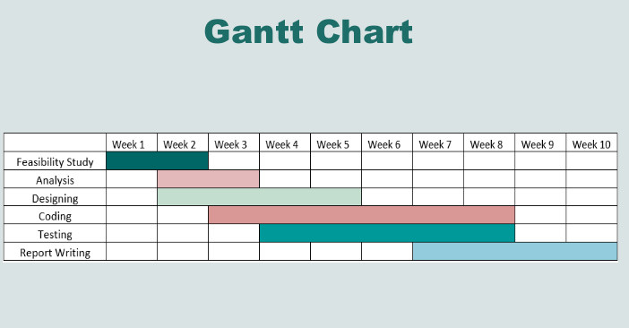
TIME DURATION

Slide 13
THANK YOU!!!!!!...........

